Slide 1
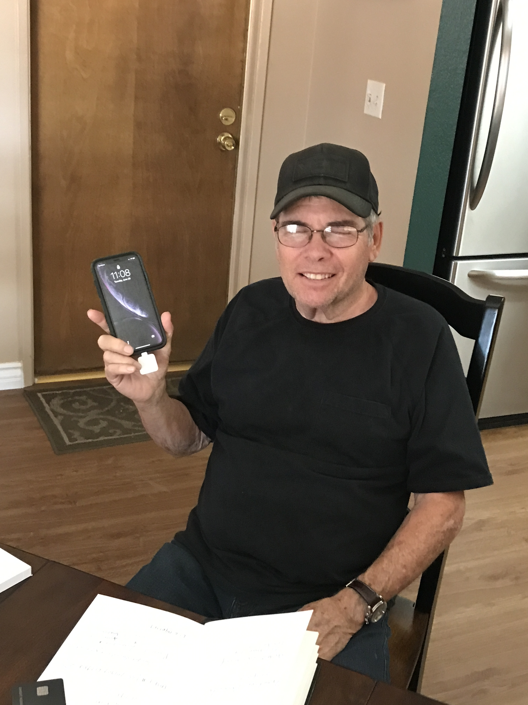
Getting Paid
By Mike Apodaca
If Dwight Can Do It . . .

Slide 2
Ways to get paid
Cash $
Online Apps
Paypal
Zelle
Venmo
Apple Pay
Google Cash
Cash App
Square
There are three ways to get paid:
Cash, Online Apps, and the Square

Slide 3
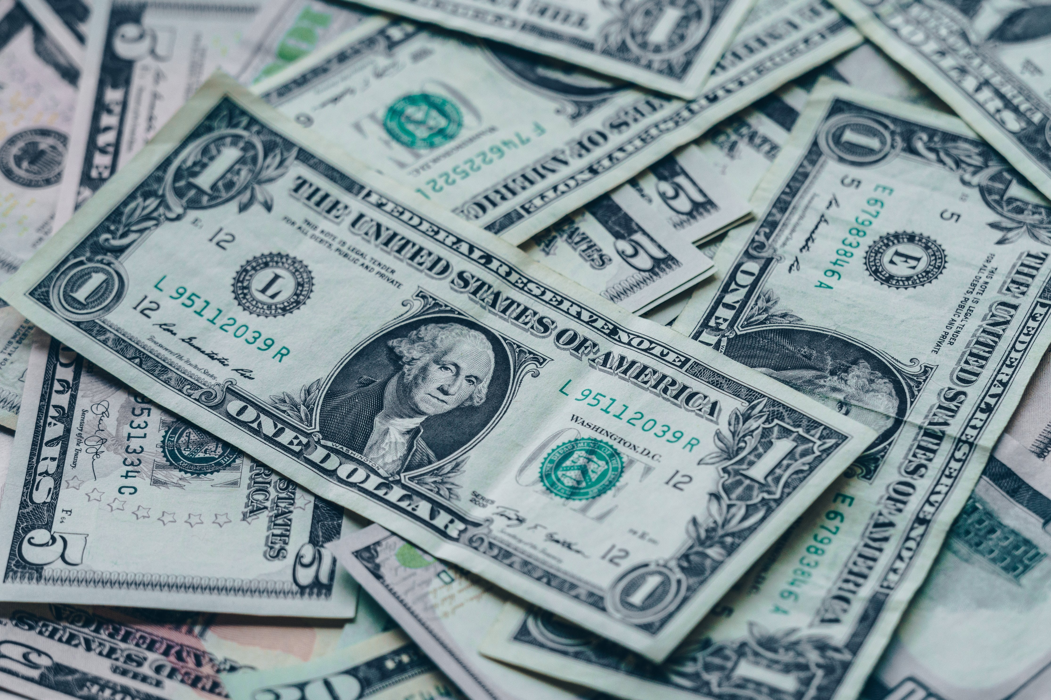
Cash
Pros
Cons
Immediacy
Chance of people carrying cash
Making change
Having large amounts of cash on hand
Record keeping on the seller

Slide 4
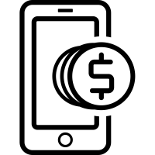
Online Apps
Pros
Cons
P2P
Immediacy
No money exchanged
Some are free
Some require email
Some charge fees
Vulnerability to cybercriminals
Reliance on Wi-Fi
Technology problems

Slide 5
 | COMPANY | FEES |  | LENGTH OF TIME FOR TRANSACTIONS TO POST
 | PayPal | No |  | Typically a day, sometimes longer
 | Venmo | No (yes for credit card usage) |  | Usually 30 minutes
 | Cash App | No (yes for credit card usage) |  | Within minutes
 | Zelle | No |  | Within minutes
 | Google Pay | No |  | Usually 24-hours. Depends on the transaction
 | Facebook Messenger | No |  | May take up to 5 days to receive funds
This chart is particularly helpful. Do the research and find out which is best for you.
Source: https://www.thebalance.com/best-payment-apps-4159058

Slide 6
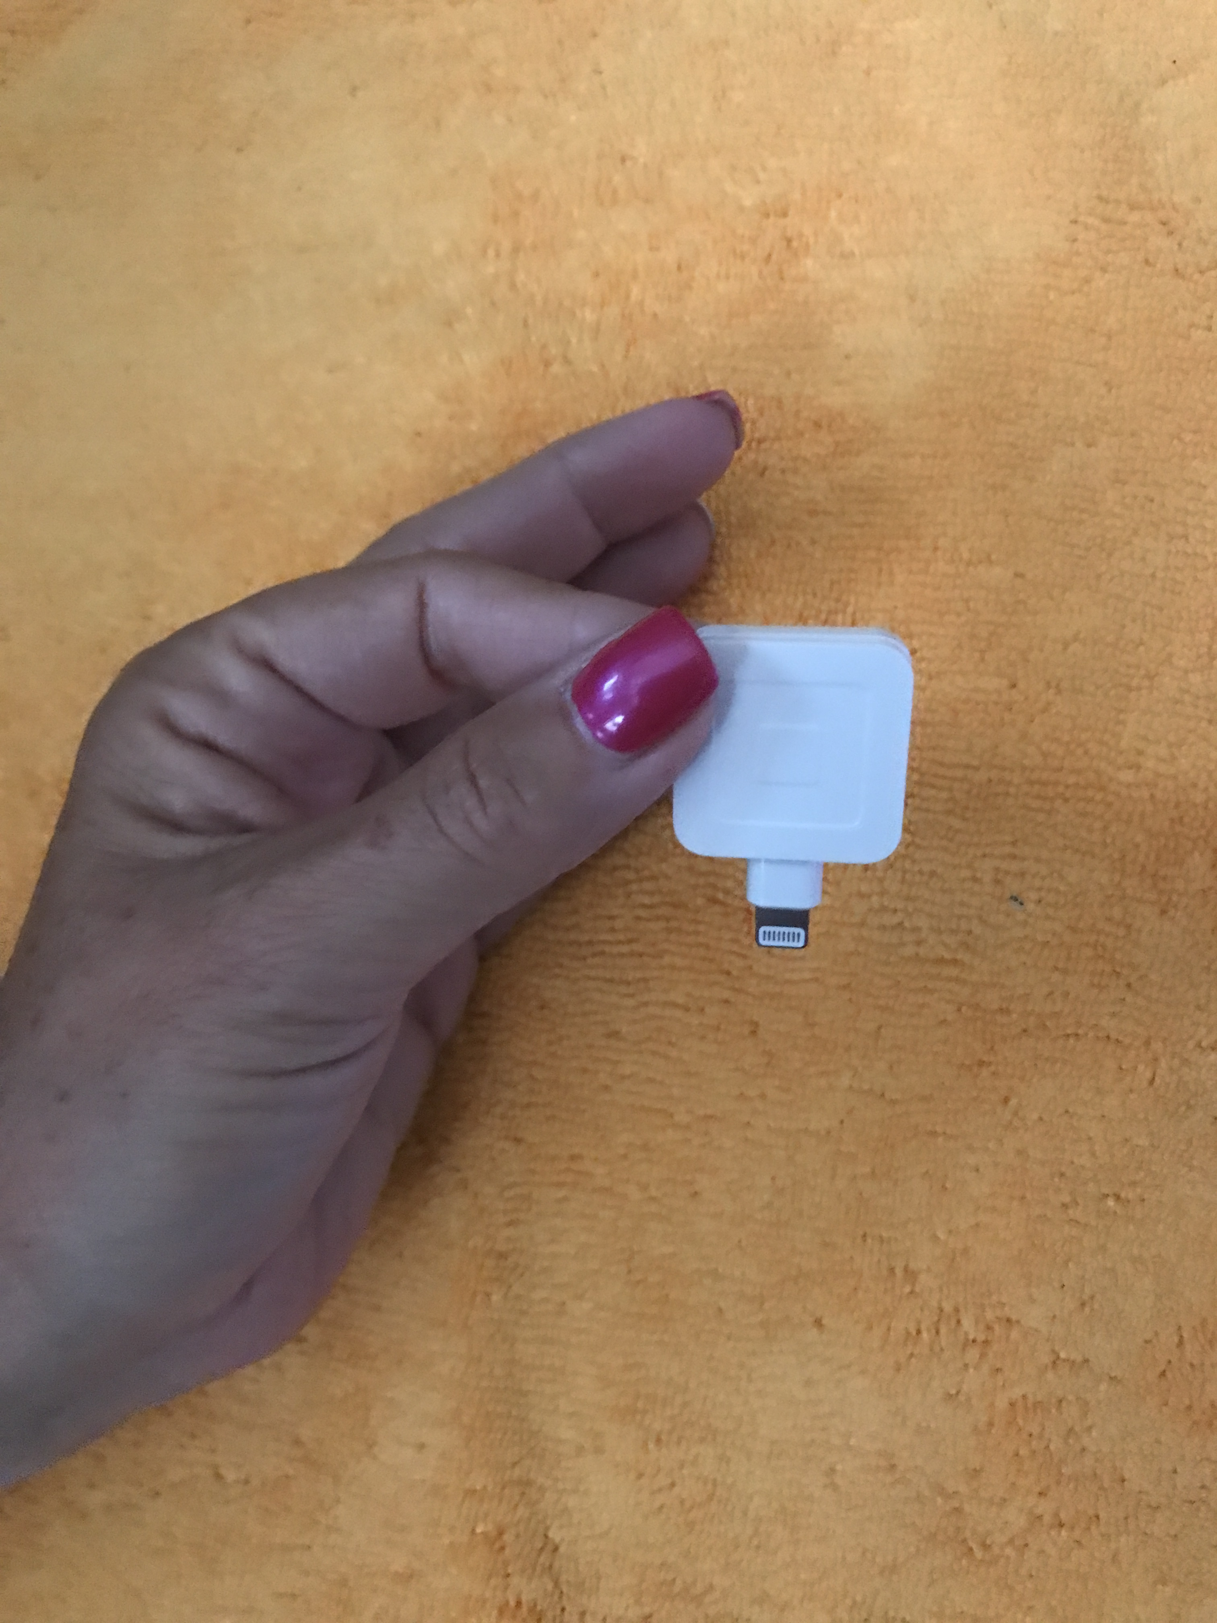
The Square
Pros
Cons
Immediacy
No money exchanged
Everyone carries cards
Fees
Reliance on signal
Technology problems: There will always be gremlins

Slide 7
The Square
Easy
Inexpensive
Set up—Let’s look closer at this

Slide 8
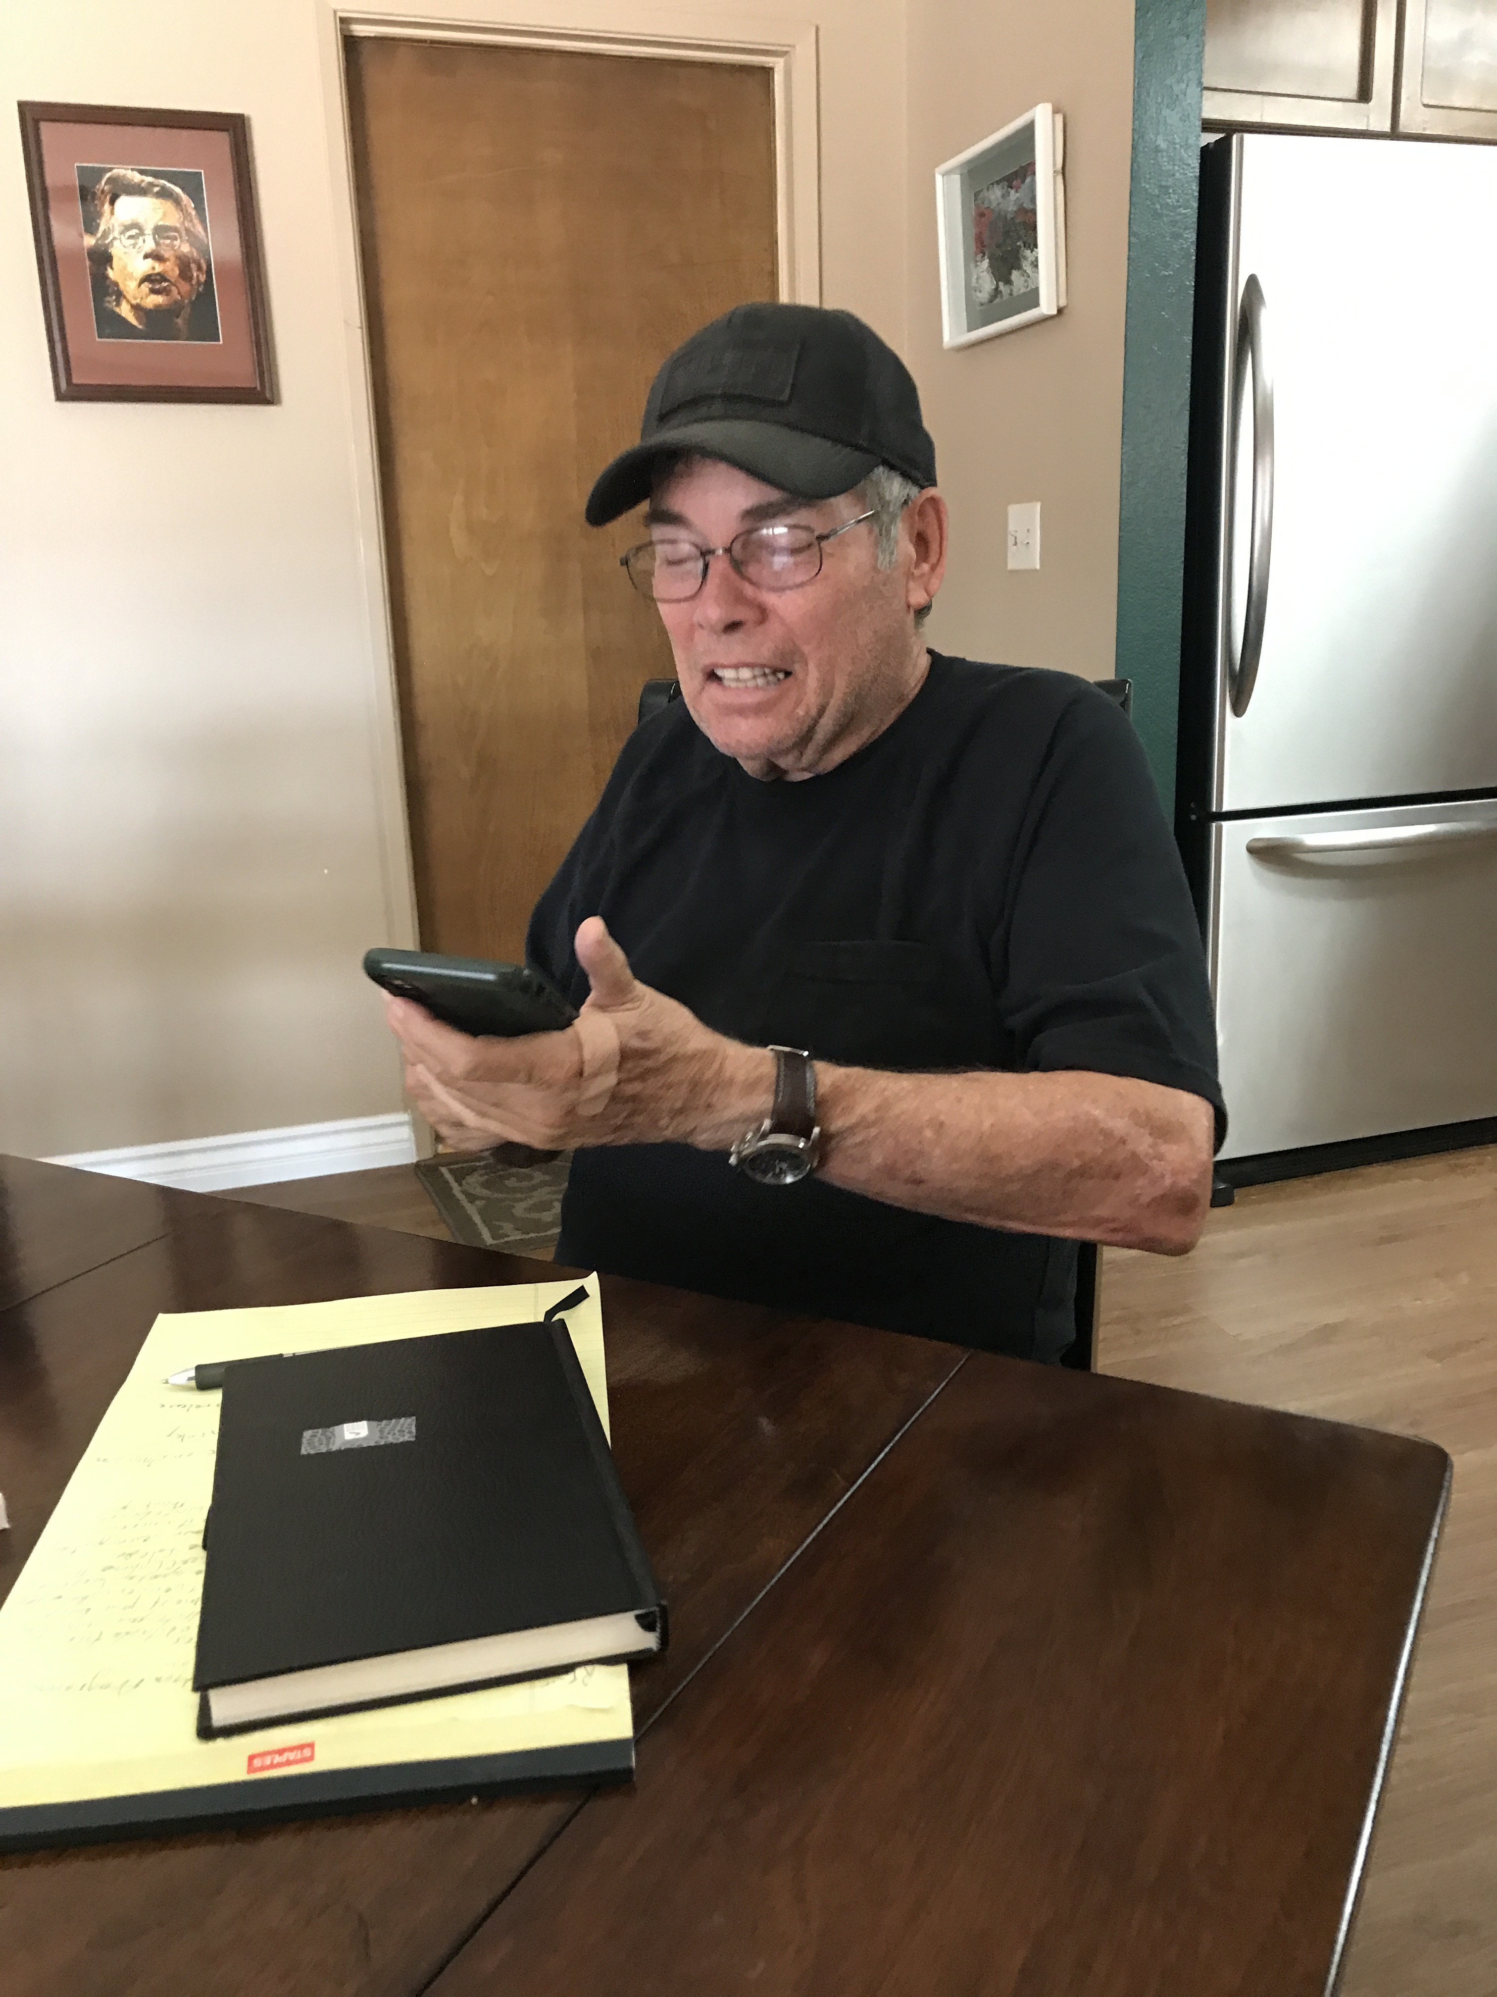
Set Up: Step 1. Download App
Create an account (Information)
Agree to the Terms
Establish a Password
Confirm Email

Slide 9
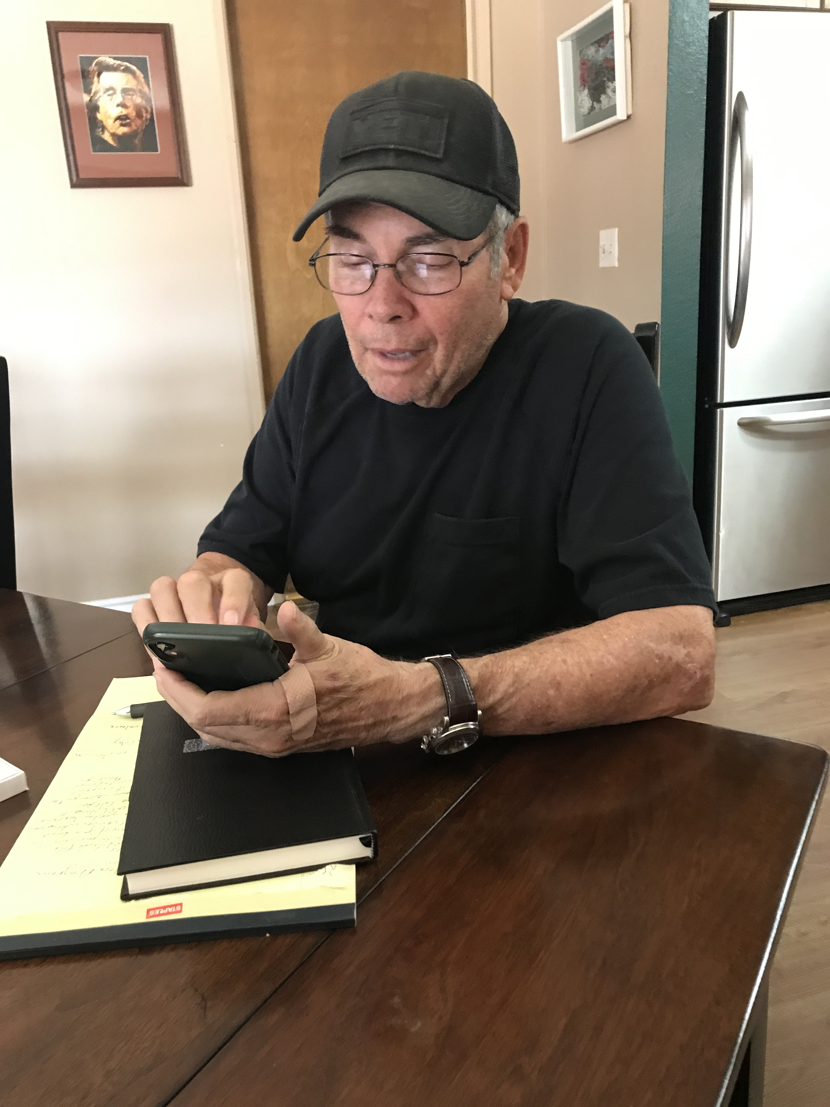
Set up: Step 2. Enable Account
Give Permission. The square needs to use parts of your phone.

Slide 10
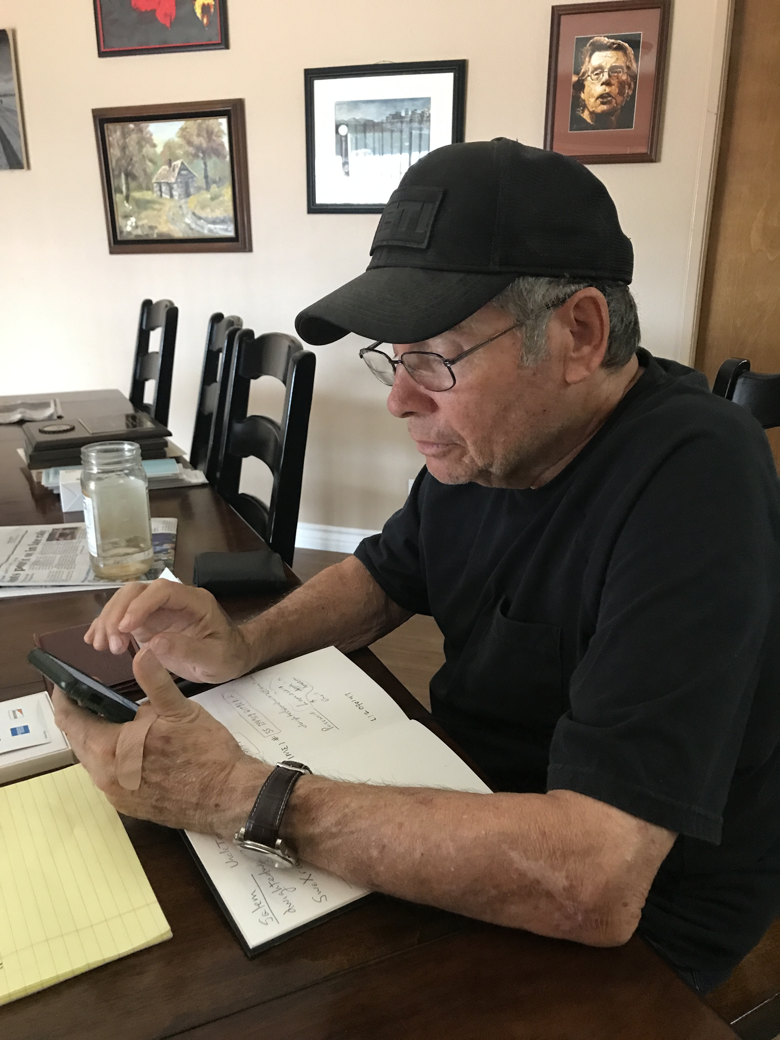
Set up: Step 3. Enter Banking Information
Name as on Check
Routing Number
Account Number
Scroll down to Continue. You will see the button to continue when you scroll.

Slide 11
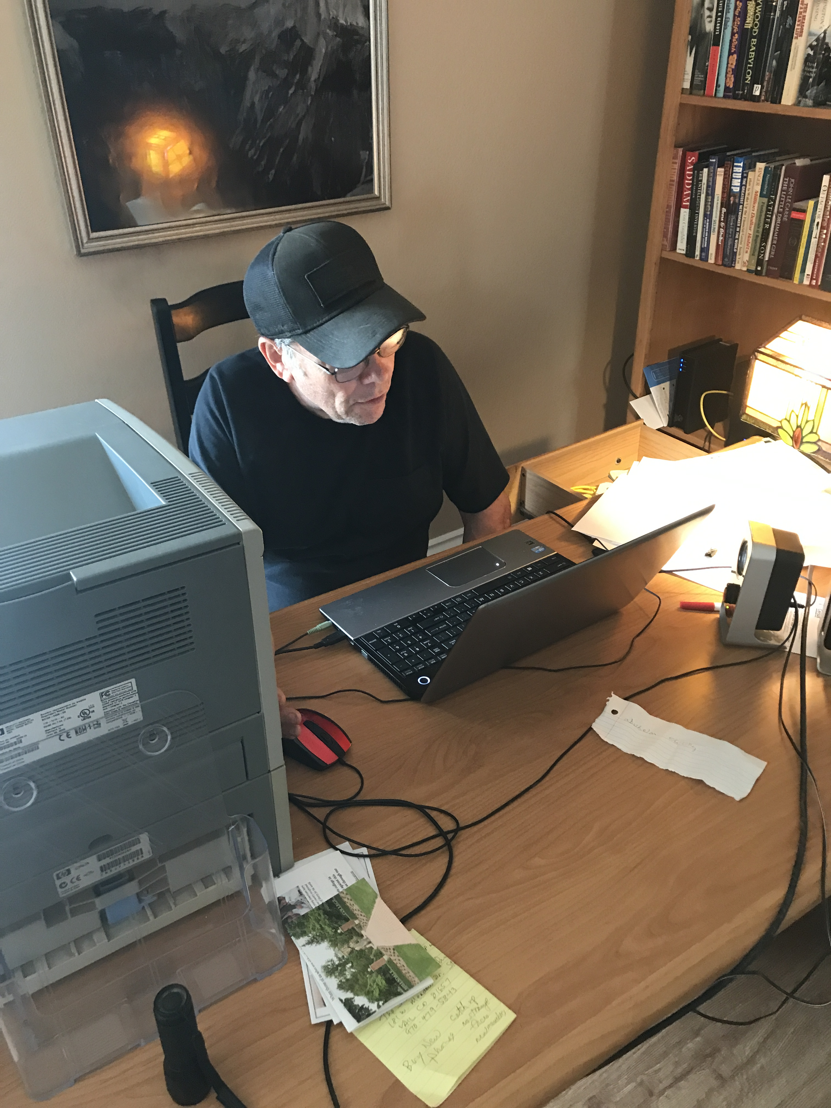
Step 4: Confirmation Email
Go to your computer and be ready to get the email confirming your account.

Slide 12
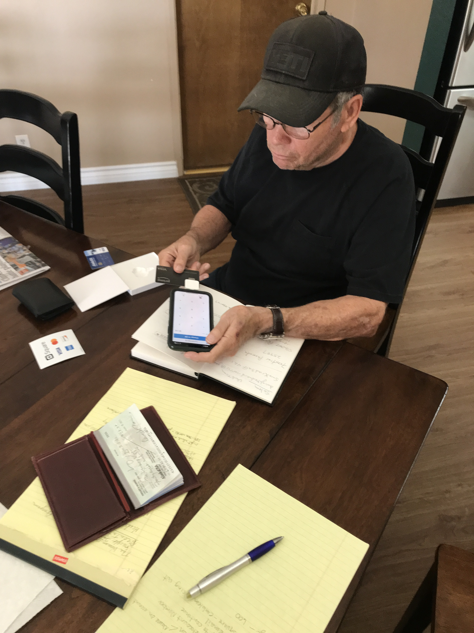
Step 5: Plug in square
Emblem Facing Out

Slide 13
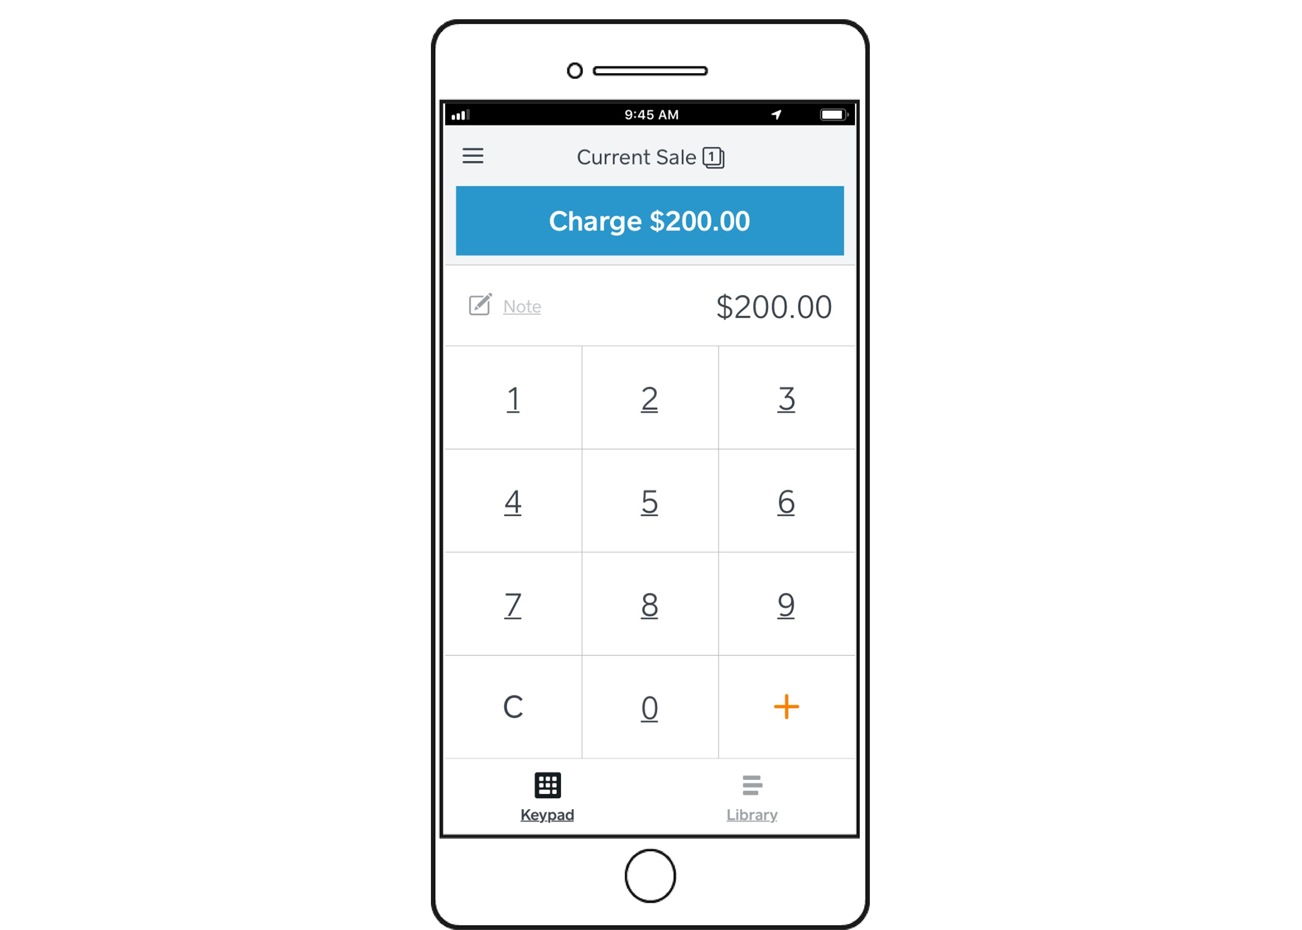
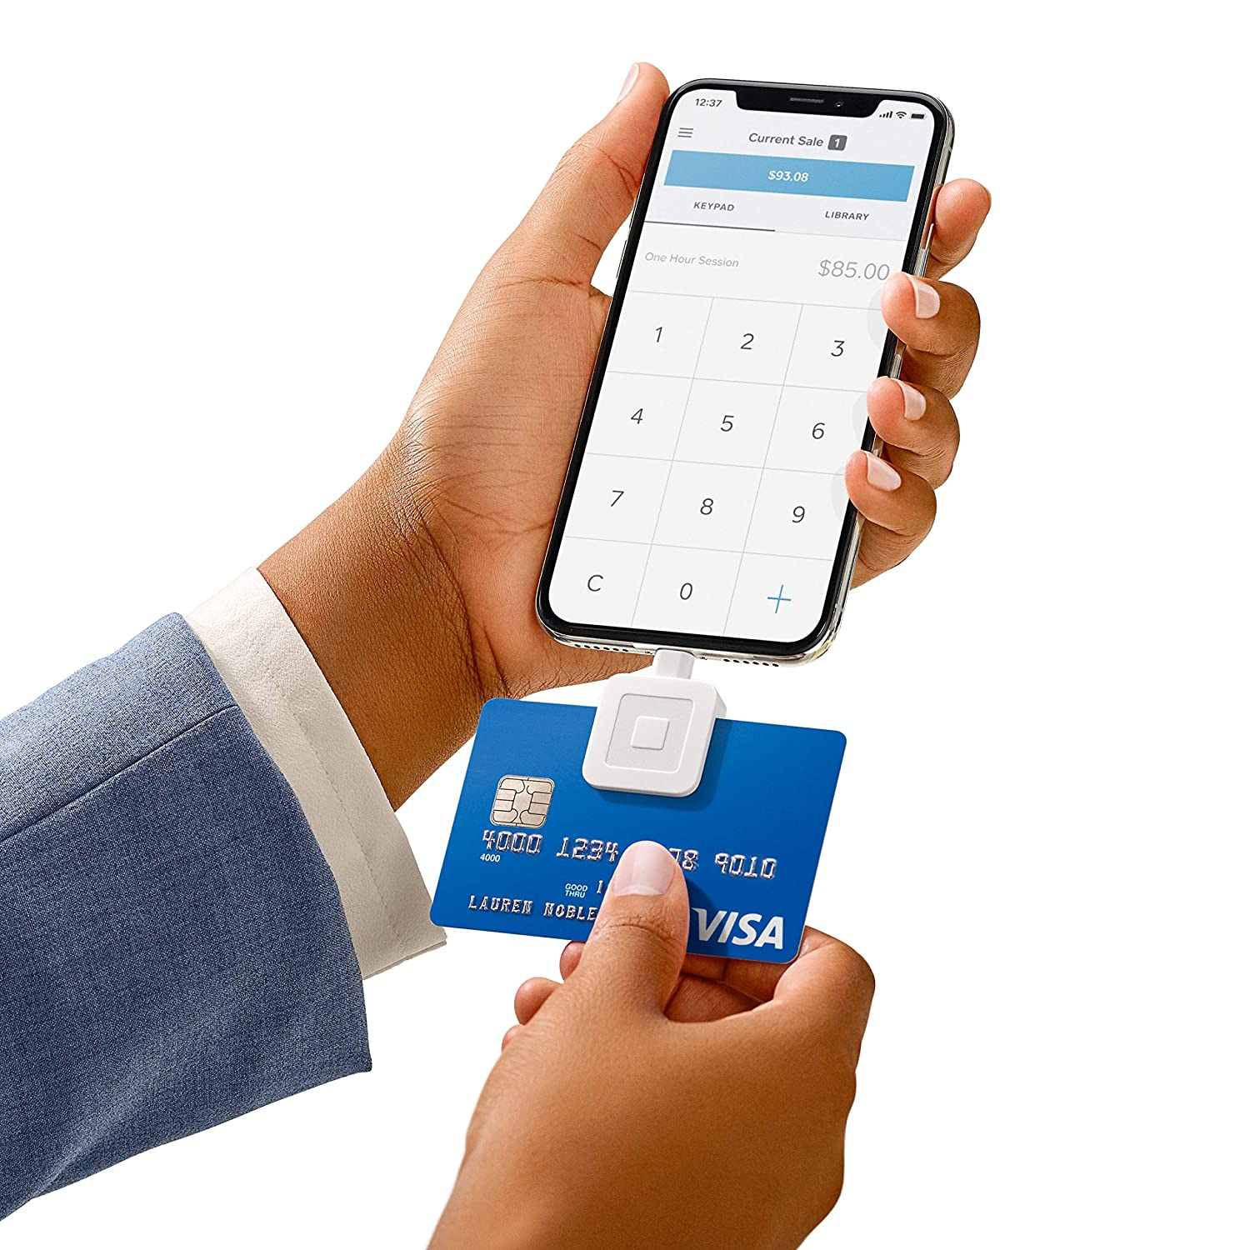
Step 6: Test Charge
Put in a Charge for a Dollar
Card Direction Matters—Facing You and Left to Right
Sign for the Charge and Press Continue

Slide 14
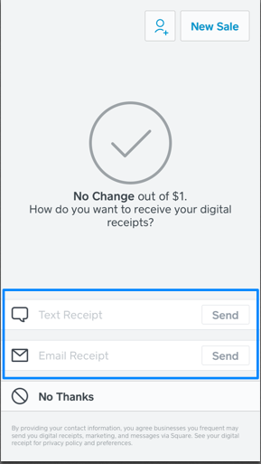
Step 7: Receipt
3 Options
Email
Text
No Receipt

Slide 15
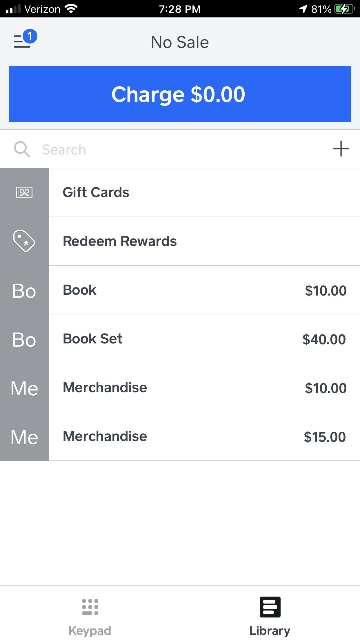
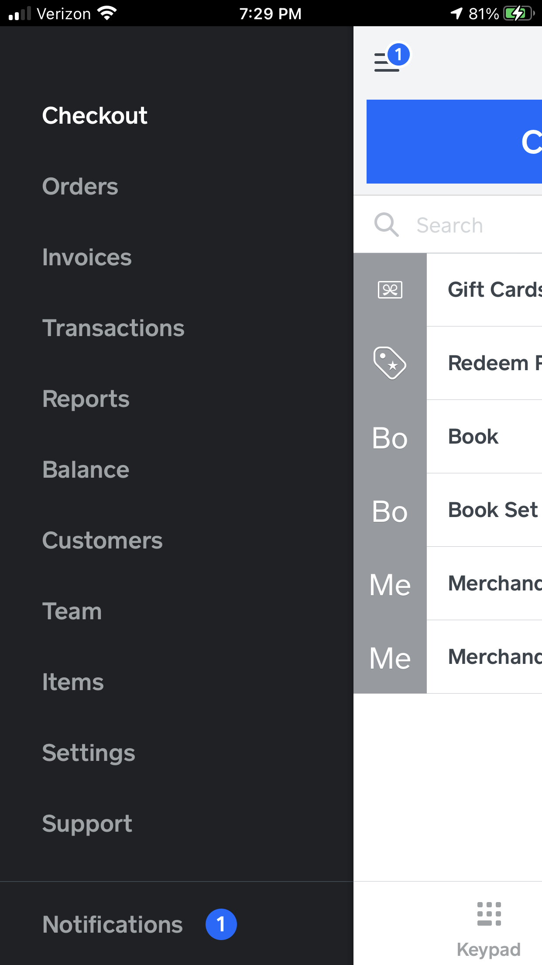
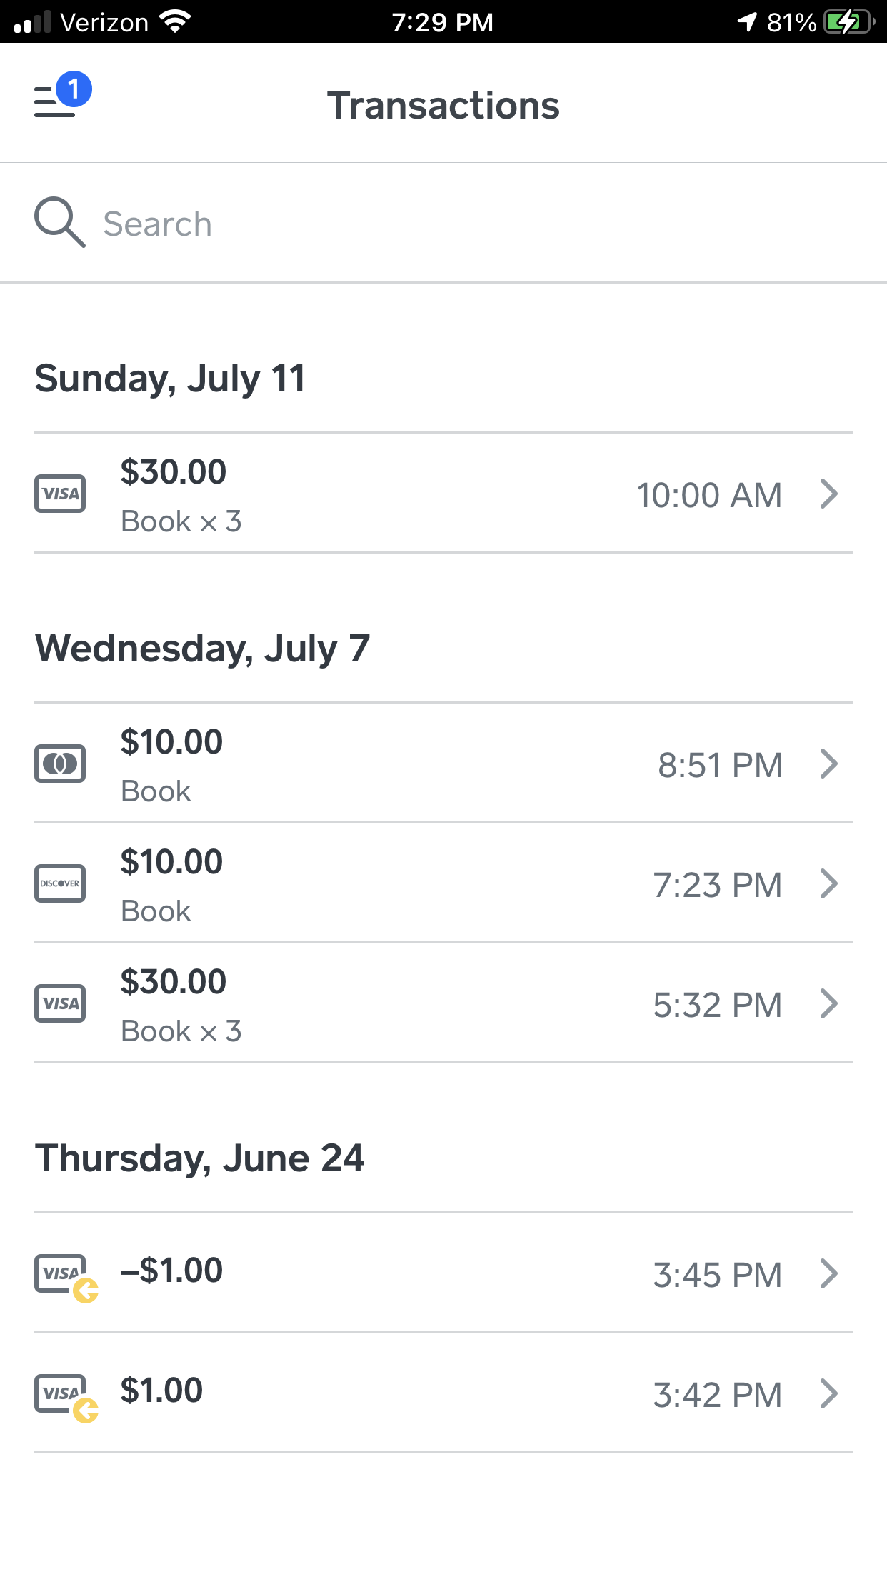
Step 8: Cancel the transaction
It’s good to do a trial run. Charge yourself a
dollar and then cancel the transaction.
Click on the three lines—upper left corner
Click Transactions
Select the Transaction
Issue the Refund
Select a Reason why
Press: Refund

Slide 16
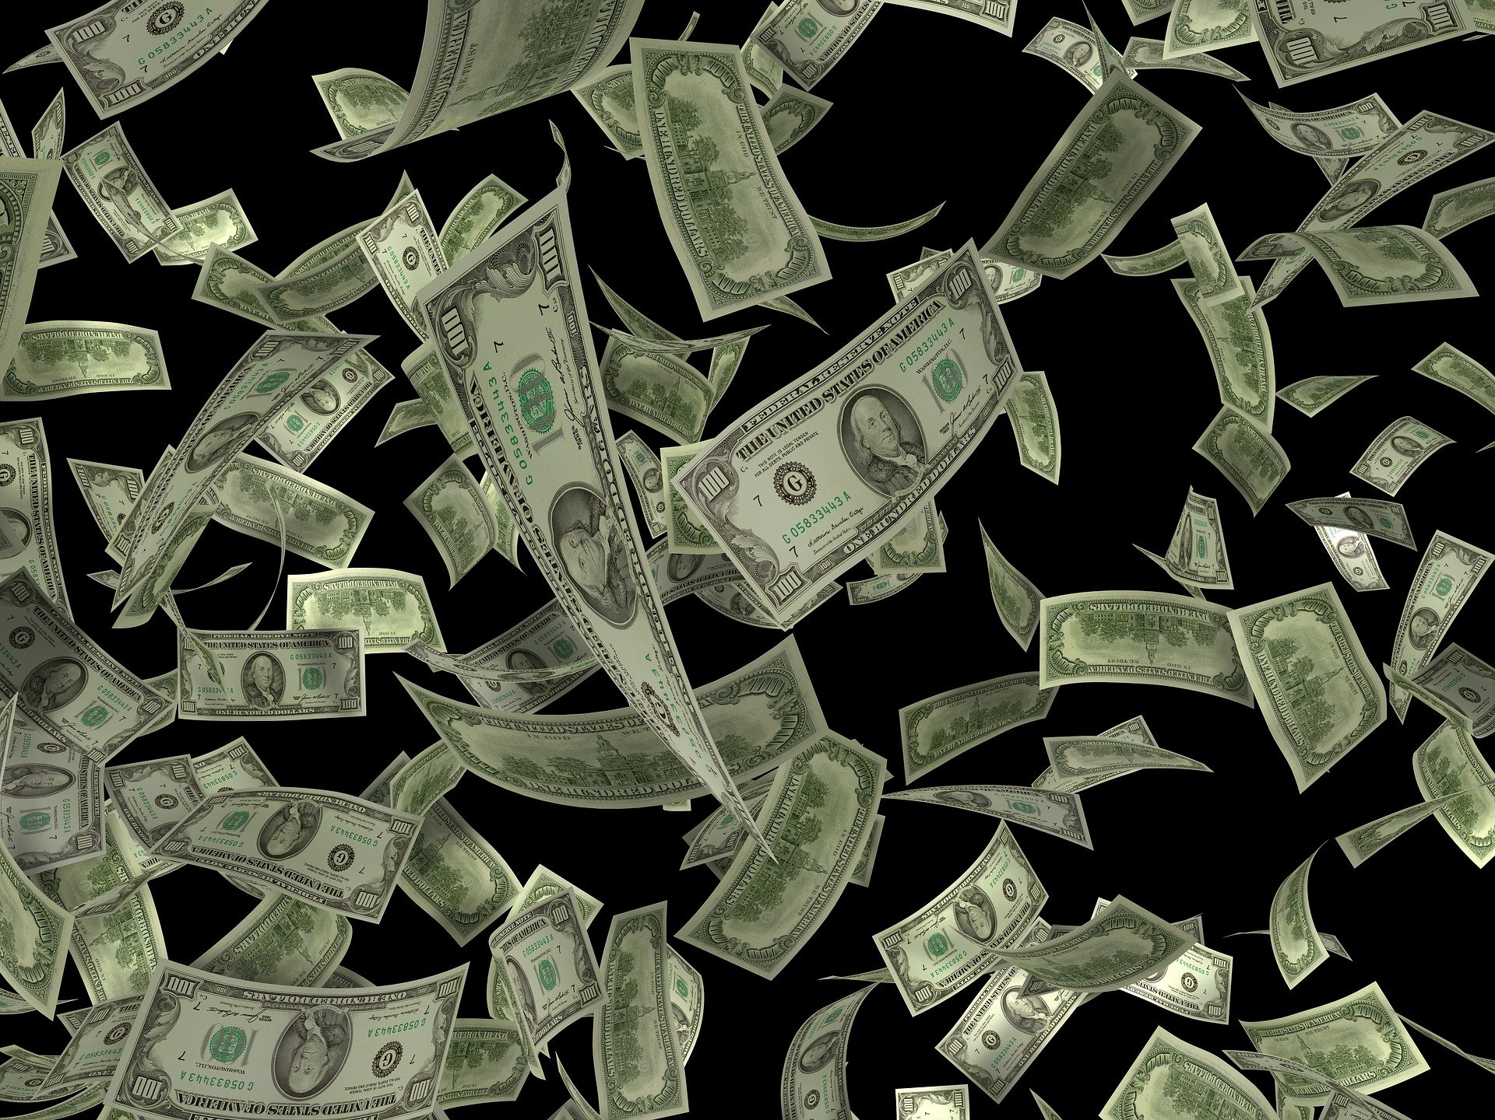
Conclusion
By having many ways to get paid, we increase the possibility of sales.
Have a favorite app (like Zelle) that can be used.
Have a square so you can take cards.
Have cash on hand for change for those who wish to pay with cash.
Happy Selling!

